Slide 1
Asymptotic Growth Rate

Slide 2
Asymptotic Running Time
The running time of an algorithm as input size approaches infinity is called the asymptotic running time
We study different notations for asymptotic efficiency.
In particular, we study tight bounds, upper bounds and lower bounds.

Slide 3
Outline
Why do we need the different sets?
Definition of the sets O (Big Oh), Ω (Omega), Θ (Theta), o (small oh), and ω (omega)
Classifying examples:
  Using the original definition
  Using limits

Slide 4
The functions
Let f(n) and g(n) be asymptotically nonnegative functions whose domains are the set of natural numbers N={0,1,2,…}.
A function g(n) is asymptotically nonnegative, if g(n)≥0 for all n≥n₀ where n₀∈N

Slide 5
The “sets” and their use – big Oh
Big “Oh” - asymptotic upper bound on the growth of an algorithm
When do we use Big Oh?
Theory of NP-completeness
To provide information on the maximum number of operations that an algorithm performs
  Insertion sort is O(n²)
    This means that in the worst case it performs at most cn² operations

Slide 6
Definition of big Oh
O(f(n)) is the set of functions g(n) such that:
there exist positive constants c, and N for which,
0≤ g(n) ≤cf(n) for all n≥N
f(n) is called an asymptotically upper bound for g(n).
Notes:
Ask questions:
Why is n a nonnegative integer
Why is f(n) real?
Why is n non negative
What is n₀ doing here?
What is c doing here?

Slide 7
To show g(n) belongs to O(f(n))
Choose a positive real number c and determine N>0 for which 0<=g(n)<=c*f(n) for all n>=N
Or, choose a positive integer N and determine c>0 for which 0<=g(n)<=c*f(n) for all n>=N

Slide 8
g(n) ∈ O(f(n))
I grow at most as fast as f
cf(n)
g(n)
N
n

Slide 9
n² + 10 n ∈ O(n²) Why?
take c = 2 and
N = 10
Clearly n²+10n ≤2n² for all n ≥ 10
1400
1200
1000
800
n² + 10n
600
2 n²
400
200
0
0
10
20
30

Slide 10
Does 5n+2 ∈O(n)?
Proof: From the definition of Big Oh, there must exist c>0 and integer N>0 such that
0 ≤ 5n+2≤cn for all n≥N.
Dividing both sides of the inequality by n>0 we get:
0 ≤ 5+2/n ≤ c.
2/n ≤ 2, 2/n>0 becomes smaller when n increases
There are many choices here for c and N.
Notes:
n^2<=cn for all n>=n0.
Let n0>0
Divide by n. We get n<c for all n>=n0, so also for n>c
We get a contradiction n<c and n>c
What do we call such a proof?

Slide 11
Does 5n+2 ∈O(n)?
If we choose N=1 then we need to find a c>0 such that 0≤5n+2≤cn for all n ≥ 1.
We know that 5+2/n≤ 5+2/1= 7. So any c ≥ 7, satisfies 0≤5n+2≤cn for all n ≥ 1. Choose c = 7, (or 14, or 100, ...)
If we choose c=6, then we need to find an N>0 such that 0≤5n+2≤6n for all n ≥ N.
We know that 0 ≤ 5+2/n≤6 for all n ≥ 2. So any N ≥ 2, satisfies 0≤5n+2≤6n for all n ≥ N. Choose N = 2.
Notes:
n^2<=cn for all n>=n0.
Let n0>0
Divide by n. We get n<c for all n>=n0, so also for n>c
We get a contradiction n<c and n>c
What do we call such a proof?

Slide 12
Does 5n+2 ∈O(n)?
In either case (we only need one c and one N!) we have a c>0 and N>0 such that 0 ≤ 5n+2≤cn for all n ≥ N. So the definition is satisfied and
5n+2 ∈O(n)
Notes:
n^2<=cn for all n>=n0.
Let n0>0
Divide by n. We get n<c for all n>=n0, so also for n>c
We get a contradiction n<c and n>c
What do we call such a proof?

Slide 13
Does n²∈ O(n)? No.
We will prove by contradiction that the definition cannot be satisfied since there do not exist a c>0 and an N>0 such that 0 ≤ n²≤cn for all n≥N
Assume by contradiction that n²∈ O(n).
From the definition of Big Oh, there must exist c>0 and integer N>0 such that 0 ≤ n²≤cn for all n≥N.
Dividing the inequality by n>0 we get 0 ≤ n ≤ c for all n≥N.
n ≤ c cannot be true for any n >max{c,N }, contradicting our assumption
So there is no constant c>0 such that n≤c is satisfied for all n≥N, and n²∉ O(n)
Notes:
n^2<=cn for all n>=n0.
Let n0>0
Divide by n. We get n<c for all n>=n0, so also for n>c
We get a contradiction n<c and n>c
What do we call such a proof?

Slide 14
Are they true?
1,000,000 n² ∈ O(n²) why/why not?
True
(n - 1)n / 2 ∈ O(n²) why /why not?
True
n / 2 ∈ O(n²) why /why not?
True
lg (n²) ∈ O( lg n ) why /why not?
True
n² ∈ O(n) why /why not?
False

Slide 15
The “sets” and their use – Omega
Omega - asymptotic lower bound on the growth of an algorithm or a problem*
When do we use Omega?
1. To provide information on the minimum number of operations that an algorithm performs (usually in the worst case)
  Insertion sort is Ω(n) in the best case
    This means that in the best case its instruction count is at least cn,
  It is Ω(n²) in the worst case
    This means that in the worst case its instruction count is at least cn²

Slide 16
The “sets” and their use – Omega (cont.)
2. To provide information on a class of algorithms that solve a problem
  Sort algorithms based on comparison of keys are Ω(nlgn) in the worst case
    This means that all sort algorithms based only on comparison of keys have to do at least cnlgn operations for some bad cases
  Any algorithm based only on comparison of keys to find the maximum of n elements is Ω(n) in every case
    This means that all algorithms based only on comparison of keys to find maximum have to do at least cn operations

Slide 17
Definition of the set Omega
Ω(f(n)) is the set of functions g(n) such that:
there exist positive constants c, and N for which,
0 ≤cf(n) ≤g(n) for all n ≥ N
f(n) is called an asymptotically lower bound for g(n).
Notes:
Ask questions:
Why is n a nonnegative integer
Why is f(n) real?
Why is n non negative
What is n₀ doing here?
What is c doing here?

Slide 18
g(n) ∈ Ω(f(n))
I grow at least as fast as f
g(n)
cf(n)
N
n

Slide 19
Is 5n-20∈ Ω (n)?
Proof: From the definition of Omega, there must exist c>0 and integer N>0 such that 0 ≤ cn ≤ 5n-20 for all n≥N
Dividing the inequality by n>0 we get: 0 ≤ c ≤ 5-20/n for all n≥N. Since c>0, we can use the inequality 0<c ≤ 5-20/n.
20/n ≤ 20, and 20/n becomes smaller as n grows.
There are many choices here for c and N.
Since c > 0, 5 – 20/n >0 and N >4
  If we choose N=5, then 1 ≤ 5-20/5 ≤ 5-20/n. So 0 < c ≤ 1. Choose c = ½.
  If we choose c=4, then 5 – 20/n ≥ 4 and N ≥ 20. Choose N = 20.
In either case (we only need one!) we have a c>o and N>0 such that 0 ≤ cn ≤ 5n-20 for all n ≥ N. So the definition is satisfied and 5n-20 ∈ Ω (n)

Slide 20
Are they true?
1,000,000 n² ∈ Ω (n²) why /why not?
(true)
(n - 1)n / 2 ∈ Ω (n²) why /why not?
(true)
n / 2 ∈ Ω (n²) why /why not?
(false)
lg (n²) ∈ Ω ( lg n ) why /why not?
(true)
n² ∈ Ω (n) why /why not?
(true)

Slide 21
The “sets” and their use - Theta
Theta - asymptotic tight bound on the growth rate of an algorithm
  Insertion sort is Θ(n²) in the worst and average cases
    This means that in the worst case and average cases insertion sort performs cn² operations
  Binary search is Θ(lg n) in the worst and average cases
    This means that in the worst case and average cases binary search performs clgn operations

Slide 22
Definition of the set Theta
Θ(f(n)) is the set of functions g(n) such that:
there exist positive constants c, d, and N, for which,
0≤ cf(n) ≤g(n) ≤df(n) for all n≥N
f(n) is called an asymptotically tight bound for g(n).
Notes:
Ask questions:
Why is n a nonnegative integer
Why is f(n) real?
Why is n non negative
What is n₀ doing here?
What is c doing here?

Slide 23
g(n) ∈ Θ(f(n))
We grow at same
rate
df(n)
g(n)
cf(n)
N
n

Slide 24
The “sets” and their use – Theta cont.
Note: We want to classify algorithms using Theta.
  In Data Structures, it is used by Oh

Slide 25
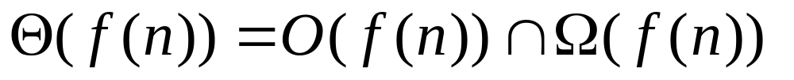
Another Definition of Theta
log n n² n⁵
5n + 3 1/2 n² 2^{n}
n^{1.5} 5n²+ 3n
nlog n
Small ω (n²)
O(n²)
Ω(n²)
Small o(n²)
Θ(n²)

Slide 26
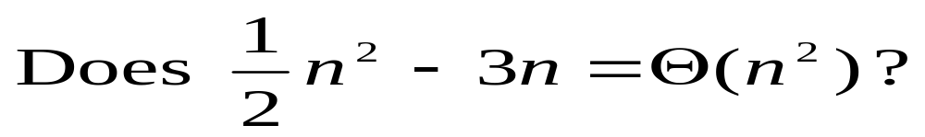
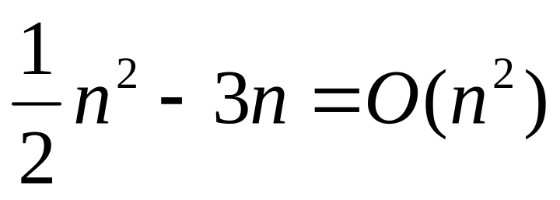
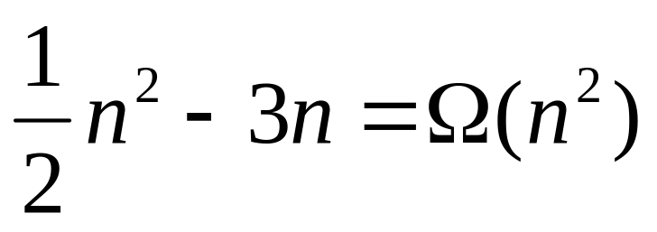
We use the last definition and show:

Slide 27
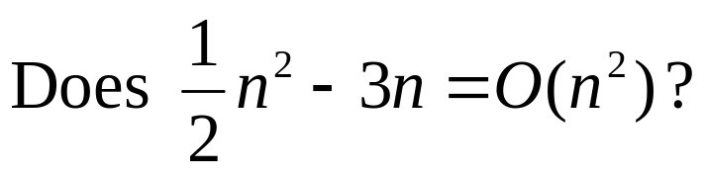
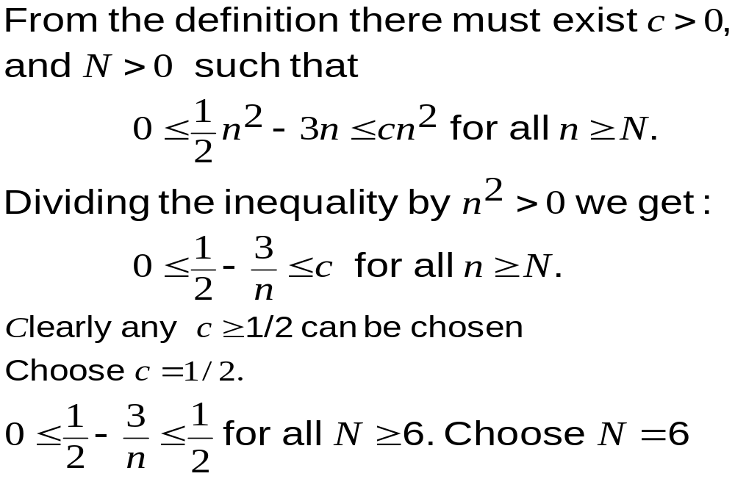

Slide 28

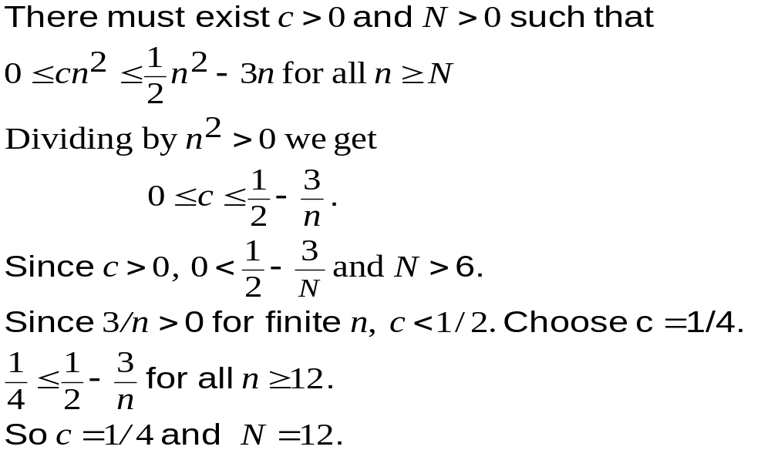

Slide 29
More Θ
1,000,000 n² ∈ Θ(n²) why /why not?
(true)
(n - 1)n / 2 ∈ Θ(n²) why /why not?
(true)
n / 2 ∈ Θ(n²) why /why not?
(false)
lg (n²) ∈ Θ ( lg n ) why /why not?
(true)
n² ∈ Θ(n) why /why not?
(false)

Slide 30
The “sets” and their use – small o
ο(f(n)) is the set of functions g(n) which satisfy the following condition:
For every positive real constant c, there exists a positive integer N, for which,
0≤ g(n) < cf(n) for all n≥N

Slide 31
The “sets” and their use – small o
Little “oh” - used to denote an upper bound that is not asymptotically tight.
  n is in o(n³).
  If c=1 n<=n³ for all n>=1
  If c=1/1000 n<=1/1000n³ for all n>=32
  n is not in o(n)
  If c=1/1000, there is no N such that n<=1/1000n for all n>=N

Slide 32
The “sets”– small omega
ω(f(n)) is the set of functions g(n) which satisfy the following condition:
For every positive real constant c, there exists a positive integer N, for which,
g(n) ≥ cf(n) >0 for all n≥N

Slide 33
The “sets”– small omega and small o
g(n) ∈ ω(f(n))
if and only if
f(n) ∈ o(g(n))

Slide 34
Limits can be used to determine Order
{
c then f (n) = Θ ( g (n)) if c > 0
if lim f (n) / g (n) = 0 then f (n) = o ( g(n))
∞ then f (n) = ω ( g (n))
Note: if f(n)=o(g(n)) then f(n)=O(g(n)), and
if f(n)= ω(g(n) then f(n)= Ω(g(n))
The limit must exist
n→∞

Slide 35
Limits can be used to determine Order
{
c>0 then g(n) = Θ ( f (n)) if c≠ 0
and c ≠ ∞
if lim g(n) / f (n) = 0 then g(n) = O ( f(n))
∞ then g(n) = Ω ( f(n))
The limit must exist
n→∞

Slide 36
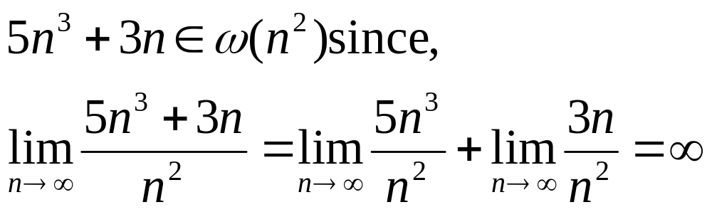
Example using limits

Slide 37
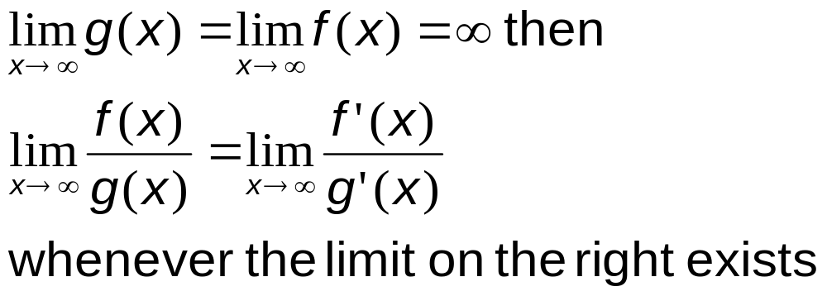
L’Hopital’s Rule
If f(x) and g(x) are both differentiable with derivatives f’(x) and g’(x), respectively, and if

Slide 38
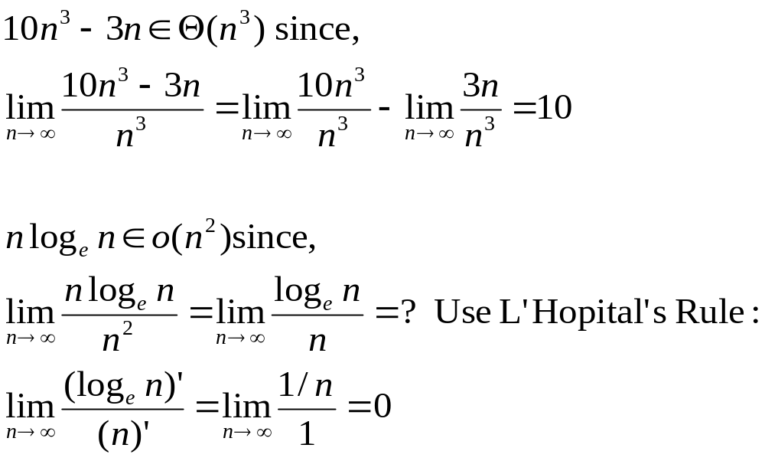
Example using limits

Slide 39
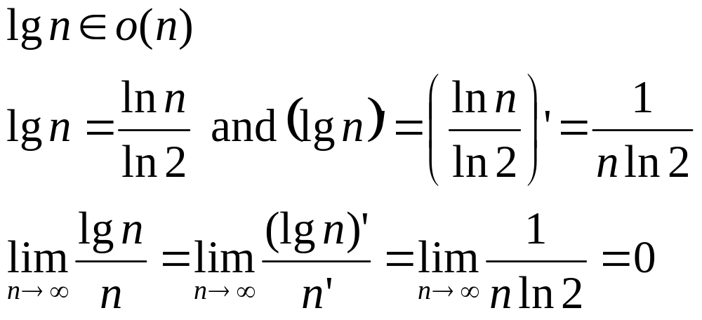
Example using limit

Slide 40
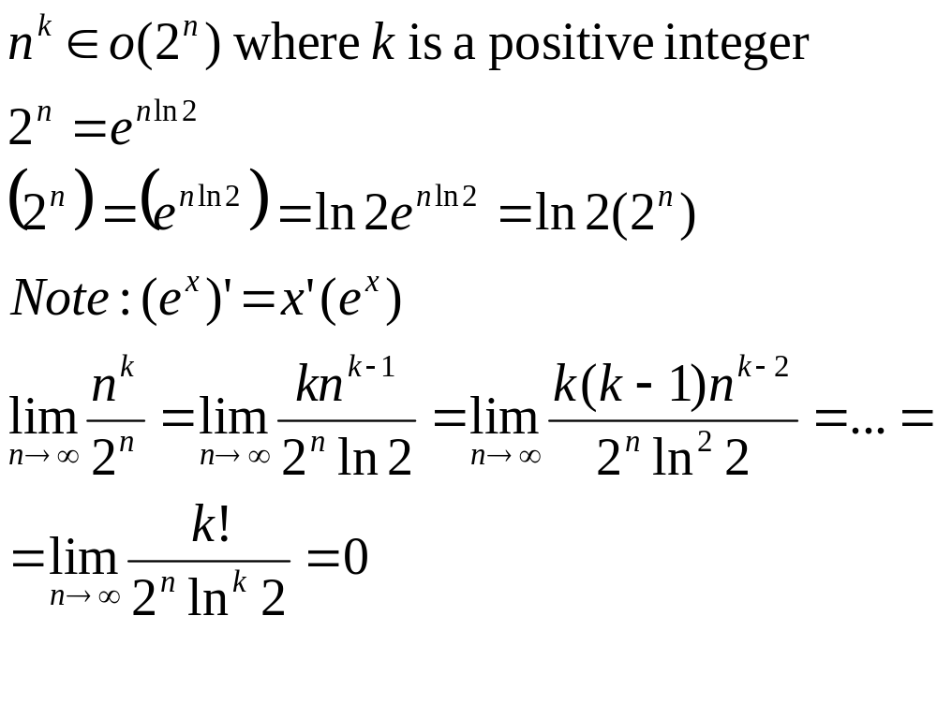
Example using limits

Slide 41
Asymptotic Growth Rate
Part II

Slide 42
Outline
More examples:
General Properties
Little oh
Additional properties

Slide 43
Order of Algorithm
Property
- Complexity Categories:
θ(lg n) θ(n) θ(n lgn) θ(n²) θ(n^{j}) θ(n^{k}) θ(a^{n}) θ(b^{n}) θ(n!)
Where k>j>2 and b>a>1. If a complexity function g(n) is in a category that is to the left of the category containing f(n), then g(n) ∈ θ(f(n))

Slide 44
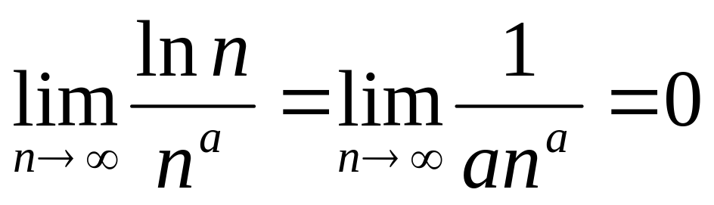
Comparing ln n with nª (a > 0)
Using limits we get:
So ln n = o(nª) for any a > 0
When the exponent a is very small, we need to look at very large values of n to see that nª > ln n

Slide 45
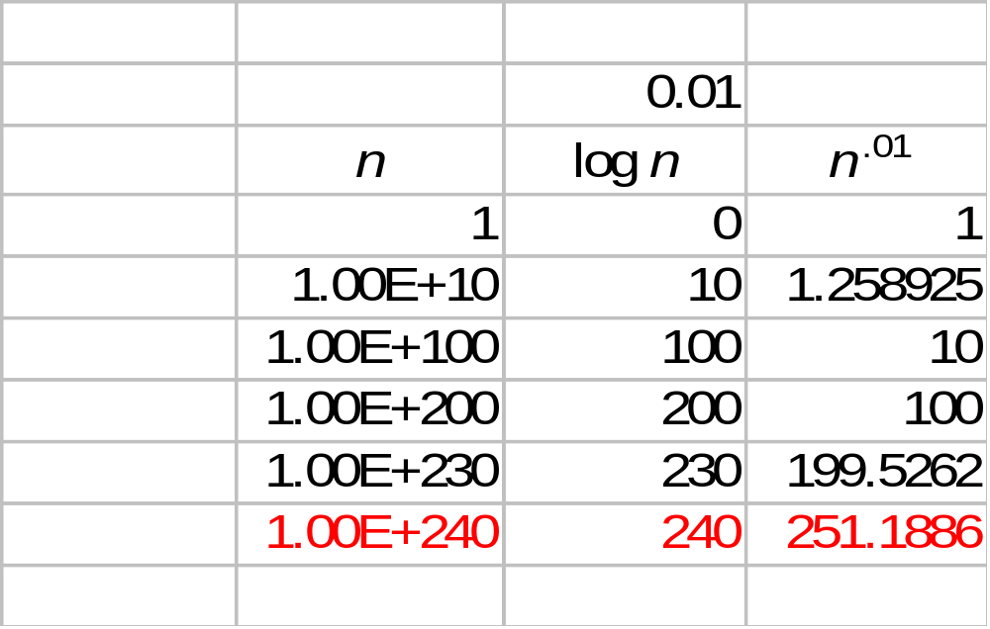
Values for log₁₀n and n^{.01}

Slide 46
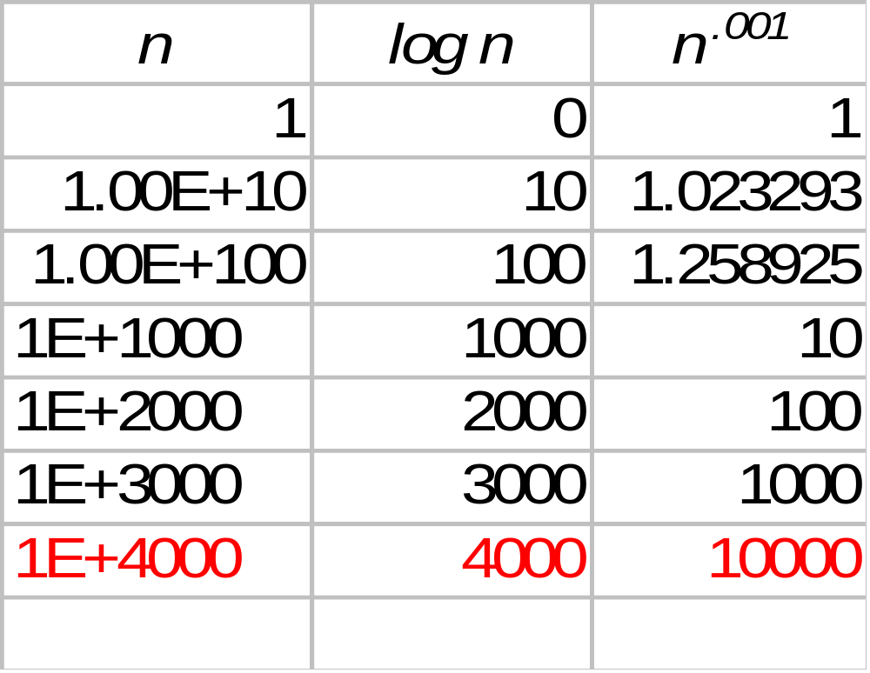
Values for log₁₀n and n^{.001}

Slide 47
main difference between O and o
O ( g (n) ) = { f (n )| there exist positive constant c and
a positive integer N such that
0 ≤ f( n) ≤ c ∗ g (n ) for all n ≥ N }
o ( g (n) ) =
{ f(n) | for any positive constant c >0, there exists a positive integer N such that 0 ≤ f( n) < c ∗ g (n ) for all n ≥ N }
For ‘o’ the inequality holds for all positive constants.
Whereas for ‘O’ the inequality holds for some positive constants.

Slide 48
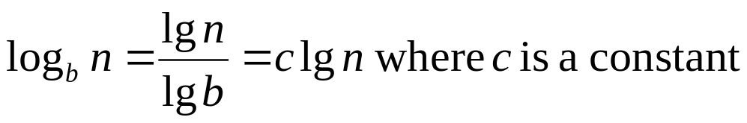
Lower-order terms and constants
Lower order terms of a function do not matter since lower-order terms are dominated by the higher order term.
Constants (multiplied by highest order term) do not matter, since they do not affect the asymptotic growth rate
All logarithms with base b >1 belong to Θ(lg n) since

Slide 49
General Rules
We say a function f (n ) is polynomially bounded if
f (n ) = O ( n^{k} ) for some positive constant k
We say a function f (n ) is polylogarithmic bounded if
f (n ) = O ( lg^{k} n) for some positive constant k
Exponential functions
  grow faster than positive polynomial functions
Polynomial functions
  grow faster than polylogarithmic functions

Slide 50
More properties
The following slides show
  Two examples of pairs of functions that are not comparable in terms of asymptotic notation
  How the asymptotic notation can be used in equations
  That Theta, Big Oh, and Omega define a transitive and reflexive order. Theta also satisfies symmetry, while Big Oh and Omega satisfy transpose symmetry

Slide 51

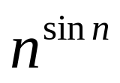
Are n and n^{sinn} comparable with respect to growth rate? yes
Increases from 0 to 1 | Increases from 1 to n
Decreases from 1 to 0 | Decreases from n to 1
Decreases from 0 to –1 | Decreases from 1 to 1/n
Increases from –1 to 0 | Increases from 1/n to 1
Clearly n^{sin n} = O(n), but n^{sin n} ≠ Ω(n)

Slide 52
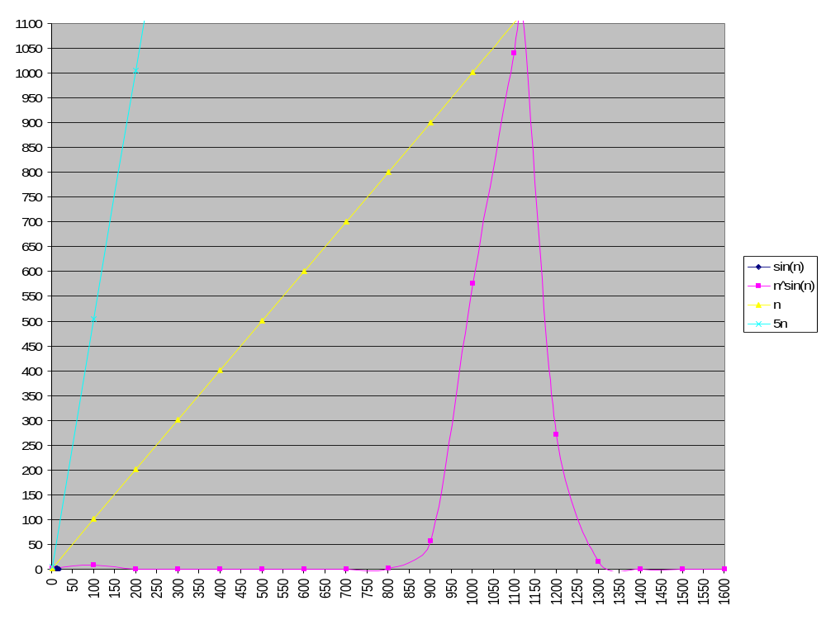

Slide 53
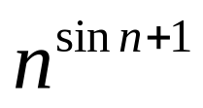
Are n and n^{sinn+1} comparable with respect to growth rate? no
Increases from 0 to 1 | Increases from n to n²
Decreases from 1 to 0 | Decreases from n² to n
Decreases from 0 to –1 | Decreases from n to 1
Increases from –1 to 0 | Increases from 1 to n
Clearly n^{sin n+1} ≠ O(n), but n^{sin n+1} ≠ Ω(n)

Slide 54
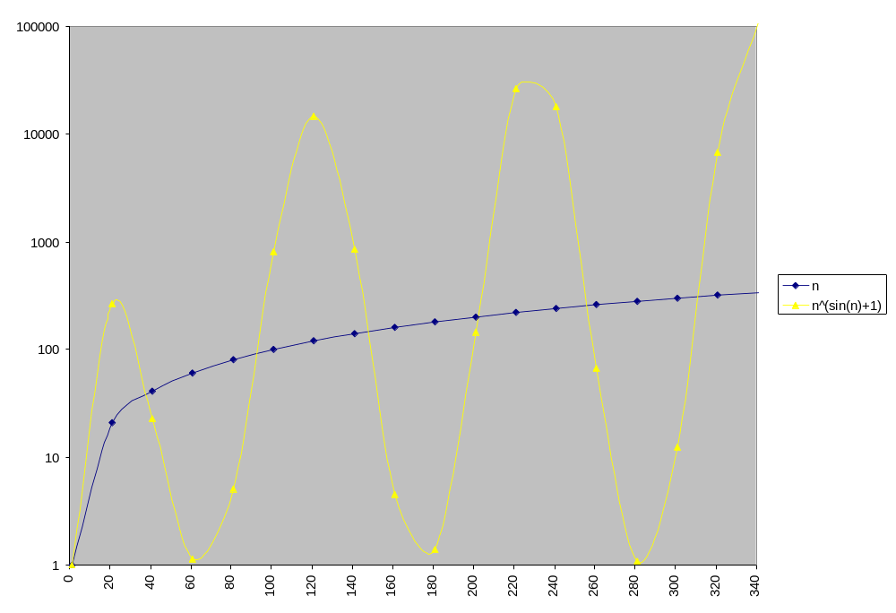
Are n and n^{sinn+1} comparable? No

Slide 55
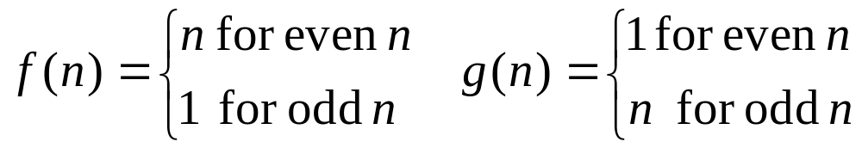
Another example
The following functions are not asymptotically comparable:

Slide 56
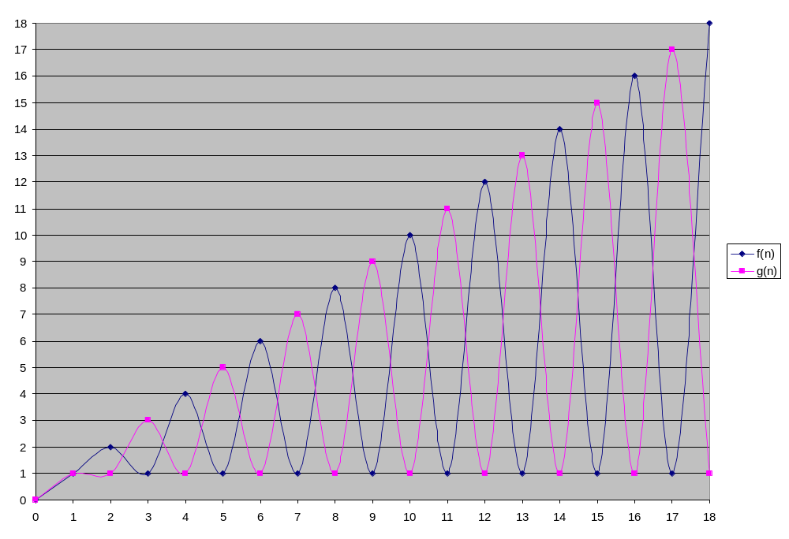

Slide 57
Asymptotic notation in equations
What does
n² + 2n + 99 = n² + Θ(n)
mean?
n² + 2n + 99 = n² + f(n)
Where the function f(n) is from the set Θ(n).
In fact f(n) = 2n + 99 .
Using notation in this manner can help to eliminate non-affecting details and clutter in an equation.
2n² + 5n + 21= 2n² + Θ (n ) = Θ (n²)

Slide 58
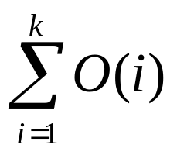
Asymptotic notation in equations
We interpret # of anonymous functions as
= # of times the asymptotic notation appears
2n² + 5n + 21= 2n² + Θ (n ) = Θ (n²)
(# of times the asymptotic notation appears
is 2)
? OK: 1 anonymous function
Not OK: O(1) + O(2) +…+ O(k)

Slide 59
Transitivity:
If f (n) = Θ (g(n )) and g (n) = Θ (h(n )) then f (n) = Θ (h(n )) .
If f (n) = Ο (g(n )) and g (n) = Ο (h(n )) then f (n) = Ο (h(n )).
If f (n) = Ω (g(n )) and g (n) = Ω (h(n )) then f (n) = Ω (h(n )) .
If f (n) = ο (g(n )) and g (n) = ο (h(n )) then f (n) = ο (h(n )) .
If f (n) = ω (g(n )) and g (n) = ω (h(n )) then f (n) = ω (h(n ))

Slide 60
Reflexivity:
f (n) = Θ (f (n )).
f (n) = Ο (f (n )).
f (n) = Ω (f (n )).
“o” is not reflexive
“ω” is not reflexive

Slide 61
Symmetry and
Transpose symmetry
Symmetry:
f (n) = Θ (g(n )) if and only if g (n) = Θ (f (n )) .
Transpose symmetry:
f (n) = Ο (g(n )) if and only if g (n) = Ω (f (n )).
f (n) = ο (g(n )) if and only if g (n) = ω (f (n )).

Slide 62
Analogy between asymptotic comparison of functions and comparison of real numbers.
f (n) = Ο( g(n)) ≈ a ≤ b
f (n) = Ω ( g(n)) ≈  a ≥ b
f (n) = Θ ( g(n)) ≈ a = b
f (n) = ο ( g(n)) ≈ a < b
f (n) = ω ( g(n)) ≈ a > b
f(n) is asymptotically smaller than g(n) if f (n) = ο ( g(n))
f(n) is asymptotically larger than g(n) if f (n) = ω( g(n))

Slide 63
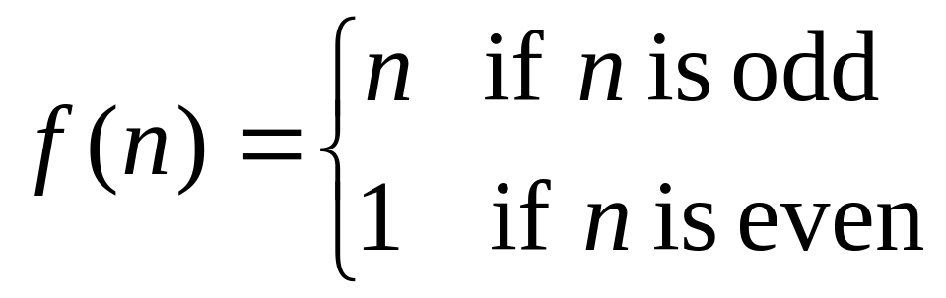
Is O(g(n)) = Θ(g(n)) ∪ o(g(n))?
We show a counter example:
The functions are:
g(n) = n
and
f(n)∈O(n) but f(n) ∉ Θ(n) and f(n) ∉ o(n)
Conclusion:
O(g(n)) ≠ Θ(g(n)) ∪ o(g(n))

